Slide 1
Feature Selection To
Distinguish
Benign vs DDoS Traffic
Shahzeb – 12/09/25

Slide 2
About the dataset
Dataset Name: CICDDoS2019
From: Canadian Institute for Cybersecurity datasets are used around the world by universities, private industry, and independent researchers.
Features/columns: (225745, 79)
Label categories: BENIGN, DDoS
Feature for analysis: flow_duration
Dataset Link: https://www.unb.ca/cic/datasets/ddos-2019.html

Slide 3
Question & Motivation
Can Flow Duration reliably separate benign from attack traffic?
Why it matters: many traffic features are skewed; mean may mislead.
Motivation: Back then in 2019, I selected features from the same dataset and didn’t have an idea which features are worth to use for detecting attacks
Goal: test whether average flow duration differs significantly between benign and DDoS flows

Slide 4
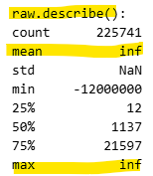

Cleaning and Preprocessing
Data was highly skewed
Replaced Infinites values with NaN
Removed NaN and replace them with the median of the affected columns
Use log‑transformation before computing sample means to mitigate heavy skew

Slide 5
Methods (Statistical Approach)
Use of CLT + log transform to handle skewness.
Bootstrapping (large‑sample draws + log transform) → build sampling distributions of mean per group.
Permutation test (label shuffle) → empirical null distribution of mean‑difference.

Slide 6
Observed Difference & Interpretation
CLT + Bootstrapping resulted in:
Observed log‑mean difference ≈ 0.10 → ~10% higher for attack flows
Avg time duration of attack packets 10% higher than BENIGN
Implication: this difference could help discriminate flow types(either DDoS or BENIGN)

Slide 7
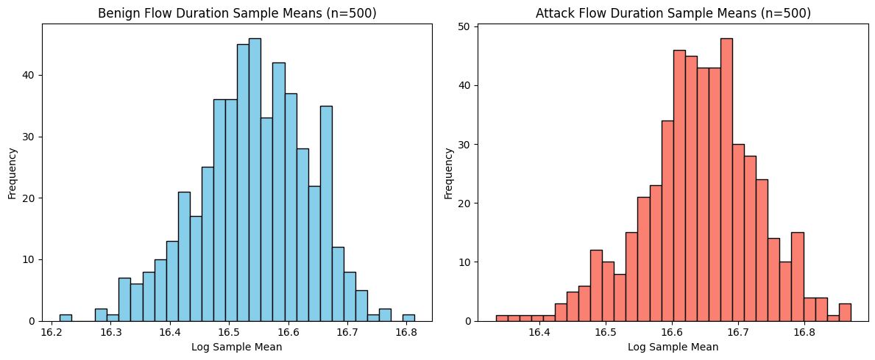
Observed log‑mean difference ≈ 0.10

Slide 8
Hypothesis
Null (H₀): No difference in average flow duration between benign and attack flows (label irrelevant)
Alternative (H₁): Attack flows have higher average flow duration than benign
Flow Duration is discriminative

Slide 9
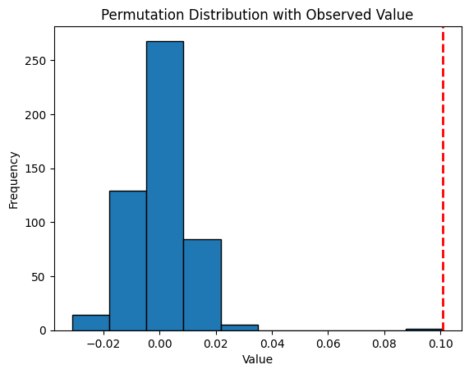
Permutation Test & p‑value
p‑value (one‑sided) ≈ 0.20%, far below than 5% threshold
Mean diff under H₀ weren’t as extreme as the observed value
Conclusion: strong evidence
labeling matters → reject H₀

Slide 10
Summary
Despite heavy skew in raw data, log‑transform + bootstrapping + permutation test allow robust inference.
Attack flows show significantly higher flow duration (≈ 10% on average).
Permutation test yields p‑value ≈ 0.002 → statistically significant.
Flow Duration is robust and discriminative feature but should be used in combination with others for best results.

